Slide 1
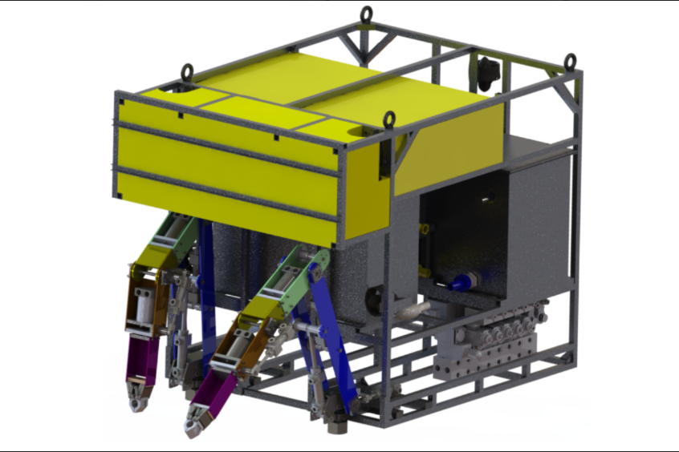
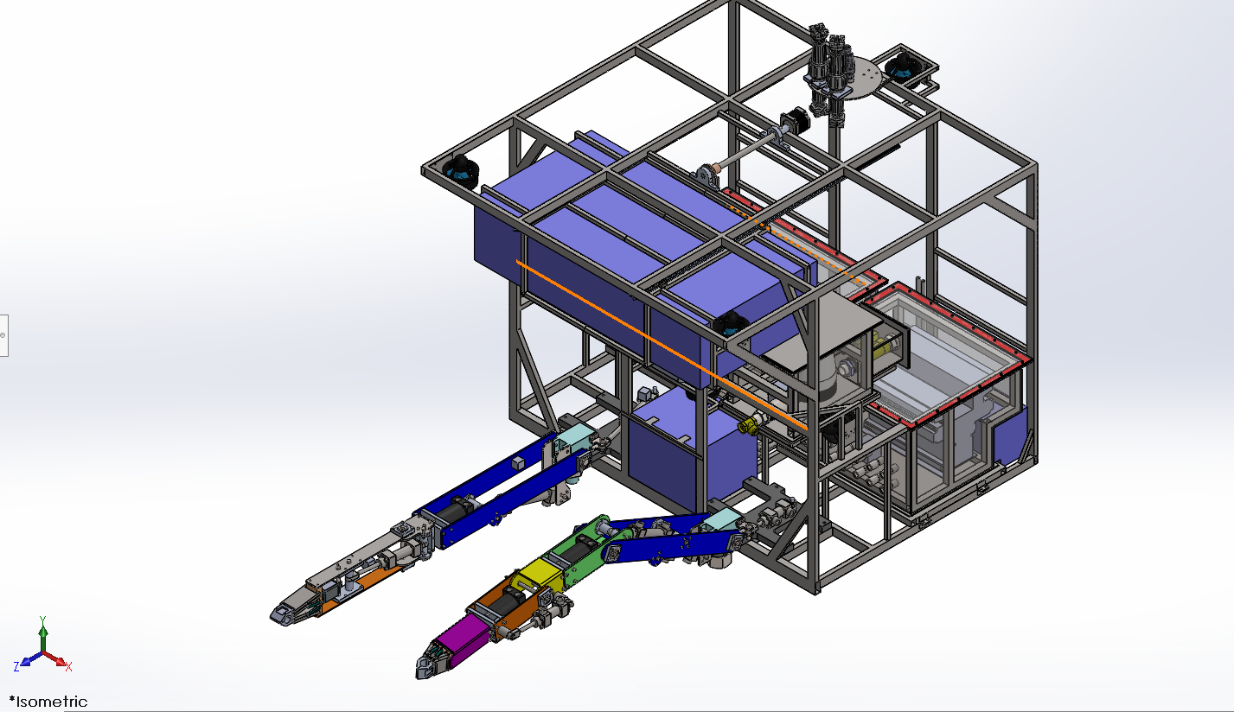
UNDERWATER ROV
Vedang Javdekar
Priyanka Jadli
Rasika Shejul
Punarvi Pallamreddy
Gaurav Kelkar
Nikhil Pachkor

Slide 2

IT2 Bldg., 1st & 2nd Floor, Blue Ridge Town Pune, Phase 1, Hinjewadi Rajiv Gandhi Infotech Park, Hinjawadi, Pune, Maharashtra 411057

Slide 3
Problem statement
To Develop Underwater ROV for sub-sea operations in oil industry
Navigation of ROV
Path planning of robotic manipulators suitable for application

Slide 4
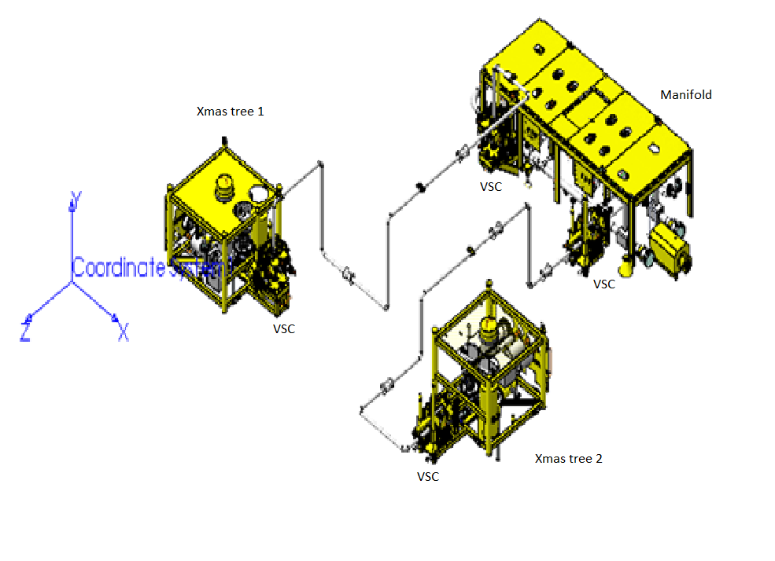
Introduction
ROVs are remote control underwater robots
It consists of embedded systems and its tethered by a series of wires that send signals between the operator and the ROV.
It is equipped with a video camera , propulsion systems and lights. Other equipment includes a manipulator , subsea tools, instruments that measure clarity , temperature and depth
The purpose of this project is to design and build the a ROV for specific application and its performance in a simulated environment.

Slide 5
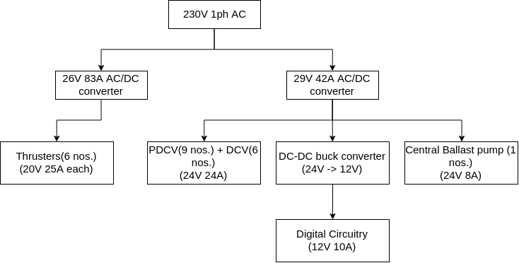
Power Supply

Slide 6
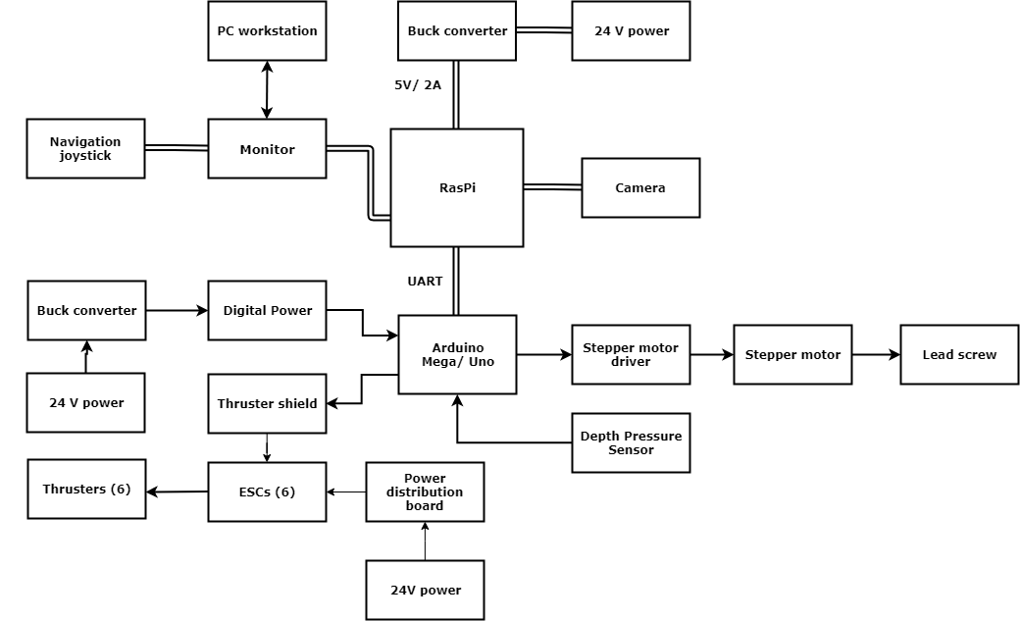
System Diagram

Slide 7
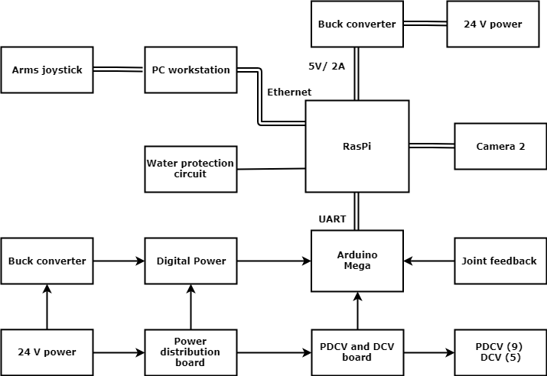
System Diagram

Slide 8
Thank You

